Slide 1
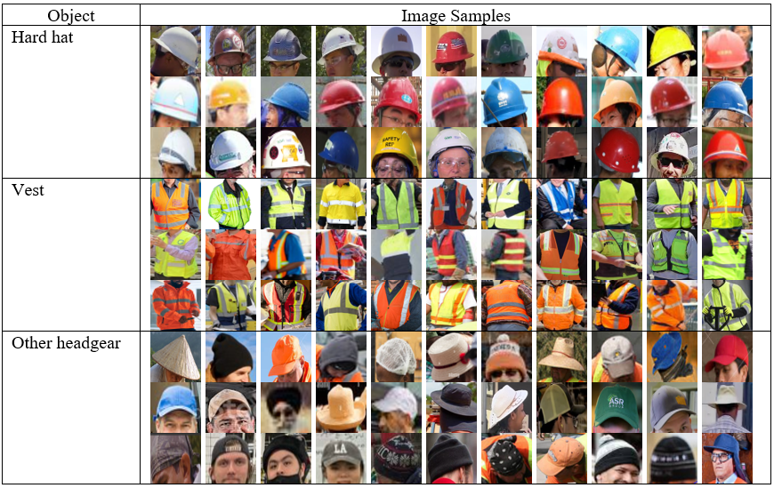
Real-Time Personal Protective Equipment Non-Compliance Recognition on AI Edge Cameras
Sanjeewani P, Neuber G, Fitzgerald J, Chandrasena N, Potums S, Alavi A, Lane C. Real-Time Personal Protective Equipment Non-Compliance Recognition on AI Edge Cameras. Electronics. 2024; 13(15):2990. https://doi.org/10.3390/electronics13152990
Presenter: Pubudu Sanjeewani
Research Fellow, Institute for Integrated and Intelligent Systems (IIIS),
Griffith University – Nathan Campus, Brisbane
Teaching and Research Sessional in Data Science, AI and Cyber Security,
RMIT University – City Campus, Melbourne
LinkedIn: https://www.linkedin.com/in/pubudu-sanjeewani-397162228/
Google Scholar: https://scholar.google.com.au/citations?user=nWCvMIAAAAAJ&hl=en&oi=ao
15/11/2024

Slide 2
Background
The International Labor Organization (ILO) [1] reports around 60,000 fatal construction site accidents annually.
One fatal accident happens every 10 minutes globally on construction sites.
In Australia, 14% of workplace fatalities from 2002 to 2014 occurred in the construction sector according to data from the Construction Industry Profile [2].
The death rate in the Australian construction industry is 34% higher than the national average.
These shocking statistics highlight the need for implementing a solid safety management system to ensure the safety of construction workers.
Effective use of Personal Protective Equipment (PPE), such as hard hats and high-visibility vests, is crucial for reducing risks.

Slide 3
Limitations
Manual monitoring is subject to human error, inconsistency, and fatigue
Continual supervision is not practical when there are too many workers
Latency and centralized processing hinder timely responses to safety incidents
Complexity and skill requirements (specialized knowledge)
High cost and infrastructure needs e.g., sensors, RFID tags
Limited accuracy and inflexibility
Require extensive cloud infrastructure and high speed internet connections

Slide 4
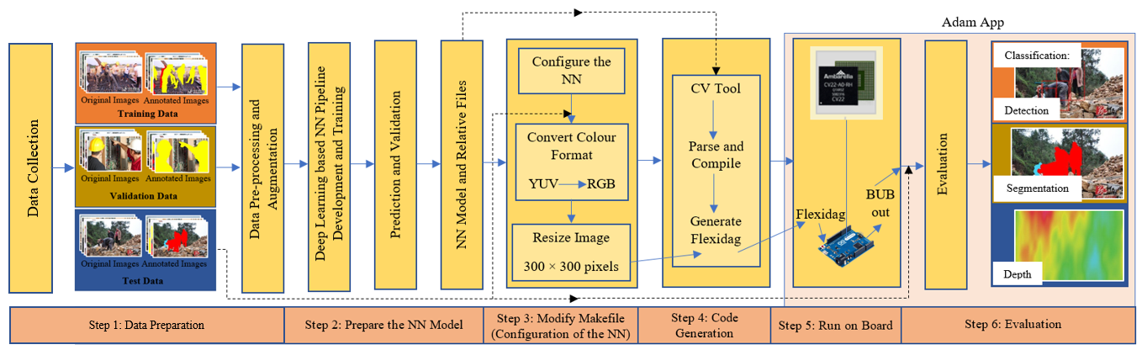
What is Proposed ?
Innovative end-to-end PPE detection model
Enhanced dataset augmentation techniques
Automatic instance segmentation and classification
Edge deployment for real-time processing
AI-enabled edge processing
Integration with external sensors
Extensive experimental validation
Comparative analysis of real-world data
Figure 1. Proposed methodology

Slide 5
AI Detection Classes—Main
Table 1. AI Detection Classes—Main
ID | Display Name | Description | Color
1 | Person: Hard hat & vest | Person wearing both a hard hat and high visibility safety vest with reflective stripes | Green
2 | Person: Hard hat only | Person wearing only a hard hat (without high visible safety vest with reflective stripes) | Yellow
3 | Person: Vest only | Person wearing only high visible safety vest with reflective stripes (without a hard hat) | Orange
4 | Person: No safety gear | Person wearing no hard hat and no high visibility safety vest with reflective stripes | Red

Slide 6
AI Detection Classes—Helper
Table 2. AI Detection Classes—Helper
ID | Display Name | Description | Mapping Main ID
5 | Person: Vest and other headgear | Person wearing only high visible safety vest with reflective stripes and headgear other than a hard hat, e.g. cap, beanie, hoodie, hat, etc. | 3
6 | Person: Other headgear only | Person wearing headgear other than a hard hat, e.g. cap, beanie, hoodie, hat, etc., and wearing no hard hat and no high visibility safety vest with reflective stripes | 4
7 | Not used: Hard hat | Hard hat instance, can be worn by a person or lying around | -
8 | Not used: Vest | Vest instance can be worn by a person or lying around | -
9 | Not used: Safety goggles | Safety goggles instance can be worn by a person or lying around | -
10 | Not used: Safety boots | Safety boots instance can be worn by a person or lying around | -

Slide 7
Data Collection
Images extracted from videos captured by a regular iPRO surveillance camera placed indoors and outdoors.
Images extracted from videos captured by mobile phone cameras while walking indoors and outdoors in Queensland, Australia.
Images in the Hard Hat Workers Dataset [3] which comprises an object detection dataset specifically curated for workplace environments where the use of hard hats is mandatory.
Images captured by digital cameras from actual construction sites.
Images downloaded from the internet (natural photographs shared on Flickr, etc.).
Images extracted by videos on the internet.

Slide 8
Dataset Preparation
The model was trained over a subset of 1859 images (~70% of the original dataset) and tested on a test dataset of 794 images (~30% of the total images).
The training dataset contained samples with different images and human characteristics, including derived characteristics (human size, human posture, orientation, blur, lightness, and occlusion) and human demographics (human-perceived gender presentation, age, hair, and skin tone).

Slide 9
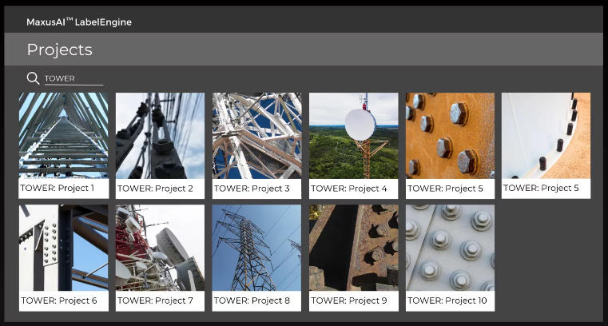
Data Annotation
Training, validation, and test images were annotated on the MaxusAI™ platform, an end-to-end, in-browser, no code, and AI-assisted active learning toolset developed by MaxusAI [4].
Label engine has been developed to label and fully segment images and videos to create high-fidelity datasets for computer vision.
The LabelEngine has the ability to label local images and videos directly in the browser without the need to install additional software or have development skills.
Data were labeled more efficiently with advanced built-in features available in the LabelEngine environment, such as
AI auto-segmentation,
active learning,
AI-enabled search,
AI uncertainty ranking, and
label analytics
to monitor the distribution of annotations to manage and avoid class imbalances and prioritize the manual effort to maximize information gain to the neural network.

Slide 10
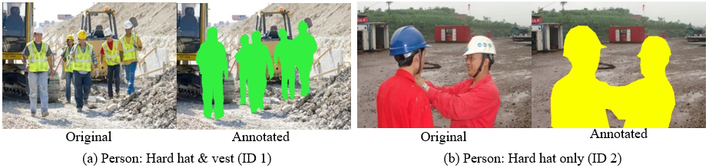
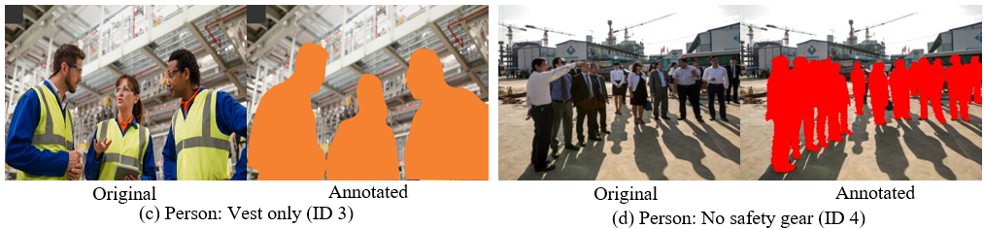
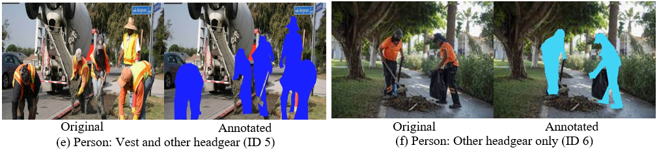
Sample Objects/Images and Annotation Samples
Figure 2. Sample object samples cropped from the original images in the dataset for different classes
Figure 3. Original and annotation samples for each class

Slide 11
Data Pre-processing
Resized to 300 × 300 pixels
Subjected to augmentation techniques to ensure the inclusion of diverse variations that are expected to occur in real-world scenarios
Augmentation techniques such as SSD random crop, random horizontal flip, padding, jpeg compression and darkening and brightening/color modification, blur, as well as randomized shift, scale, and rotations (between −15◦ and 15◦) were applied.
Filtering such as dropping images without faces, was not applied.
This decision was likely made to ensure the model is exposed to a diverse range of scenarios, including those without any detectable faces. This helps train a more generalizable model that can handle various generalizability of the model by exposing it to a wide range of variations that are expected in real-world scenarios.
By augmenting the dataset with diverse transformations, the model becomes better equipped to handle different object positions, scales, lighting conditions, and image qualities during inference.
Notes:
Several pre-processing techniques were applied to the data before input to the system.

Slide 12
Training
A handful of AI CV models that iPRO/Ambarella CV Tool can convert were identified for determining the most appropriate model for the application.
Among them, YOLO v5 and SSD MobileNet V2 were identified as optimal for evaluation due to their high accuracy and speed that allow obtaining detection in real-time speed using iPRO cameras.
Several on-camera speed tests were performed on multiple cameras, and the runtime speed statistics were evaluated for YOLO v5 and SSD MobileNet V2.
Among these models, SSD MobileNet V2 was identified as having the best performance on the available hardware, and therefore, SSD MobileNet V2 was used for the backbone of the system.
MobileNetV2 is specifically designed to be lightweight and efficient, making it well-suited for deployment on resource-constrained devices like mobile phones, edge devices, and IoT devices.
Table 3. Average Runtime Speed Statistics for Several On-time Speed Tests
Model Name | Average Runtime Speed (s) |  | Final Average Runtime Speed (s)
 | Camera 1 | Camera 2
YOLO v5 | 2.5 | 3.0 | 2.75
SSD MobileNet V2 | 0.2 | 0.2 | 0.20

Slide 13
Evaluation and Results
The AI model was implemented, trained, and tested using TensorFlow 1.15.5 and CUDA 10.0. TensorFlow Object Detection API was used to train the models.
During training, the model performance was monitored periodically on the validation set by calculating COCO evaluation metrics.
The overall performance of the model was evaluated using several metrics such as Intersection over Union (IoU), Average Precision (AP), Average Recall (AR) values class-wise, Mean Average Precision (mAP) and Mean Average Recall (mAR), the standard metrics for evaluating computer vision classifiers based on factors such as the imbalance of the dataset.
The best model was selected by monitoring the COCO scores on the validation set, and training was stopped if additional training did not show any improvements in the metrics for 90 min.

Slide 14
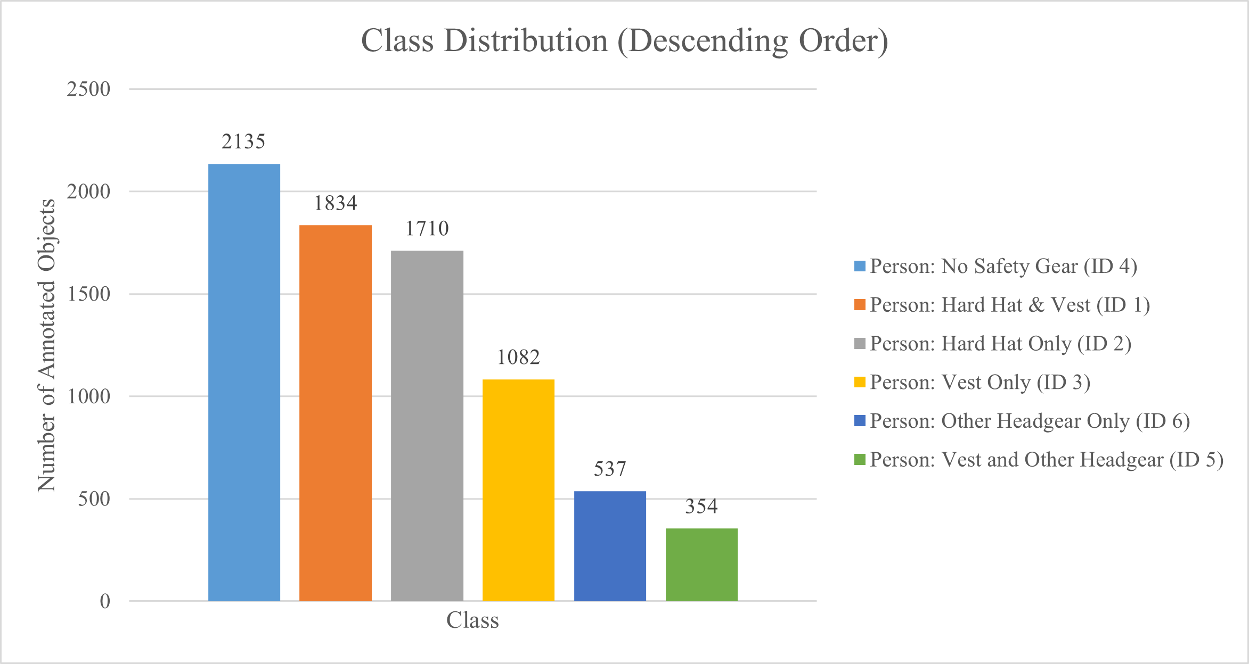
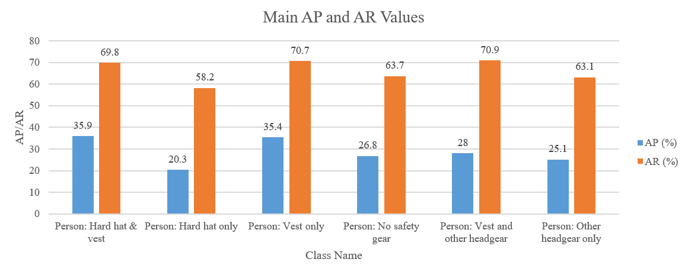
Class Distribution and Main AP and AR Values
Figure 4. Class distribution
Figure 5. Main AP and AR values for each class

Slide 15
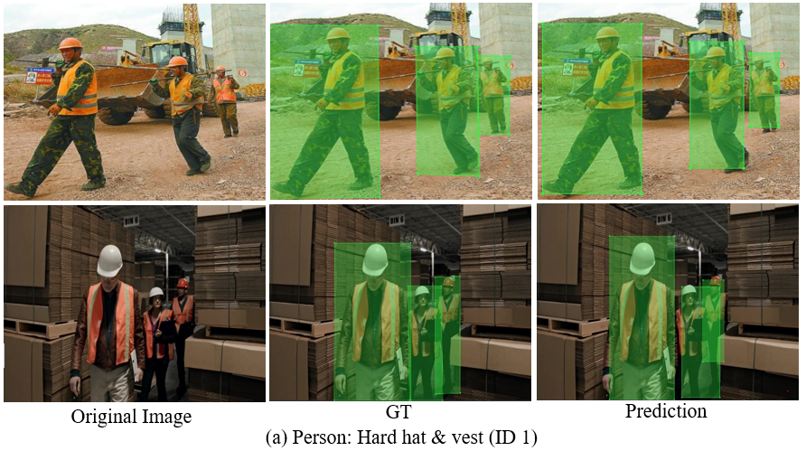
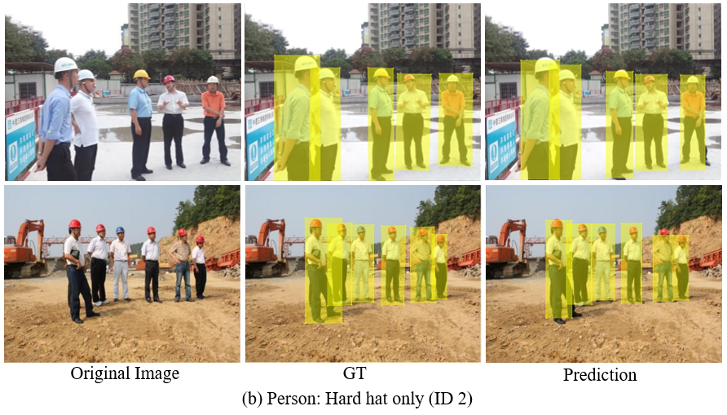
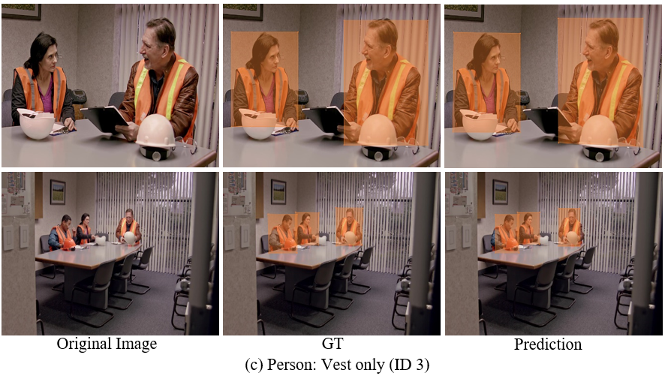
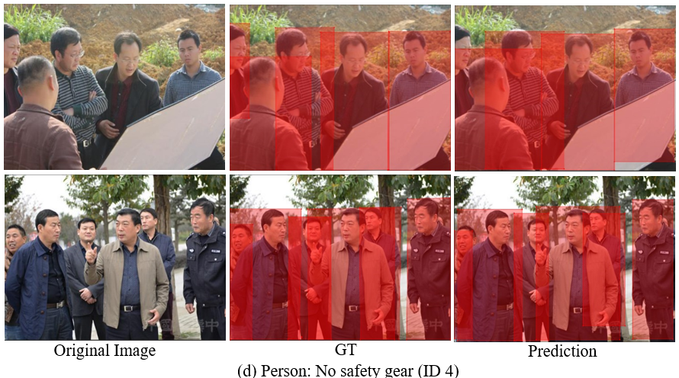
Sample Prediction Results of Selected Classes
Figure 6. Sample prediction results of selected classes, corresponding GT images, and original images

Slide 16
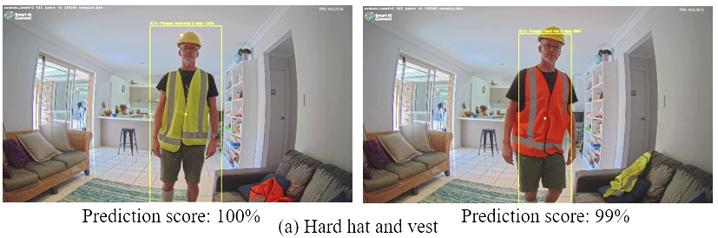
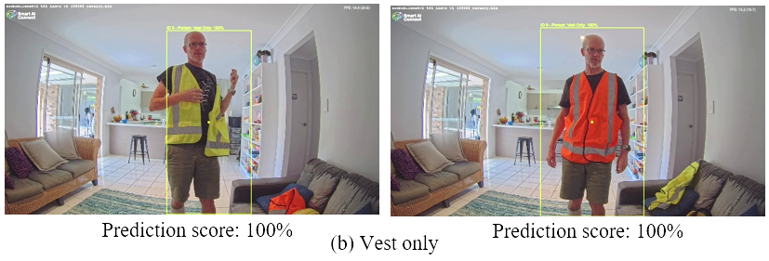
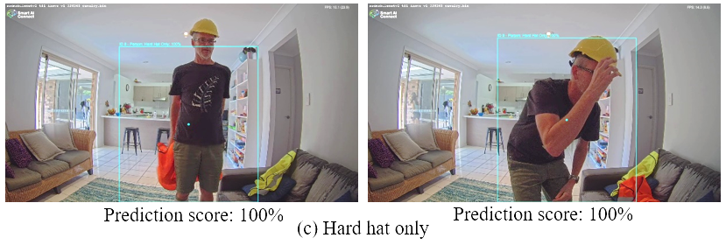
Sample Prediction Results on Real-world Images
Figure 7. Sample prediction results obtained by an iPRO camera on real-world images for hard hat
and vest class, vest-only class, and hard hat-only class with their prediction scores

Slide 17
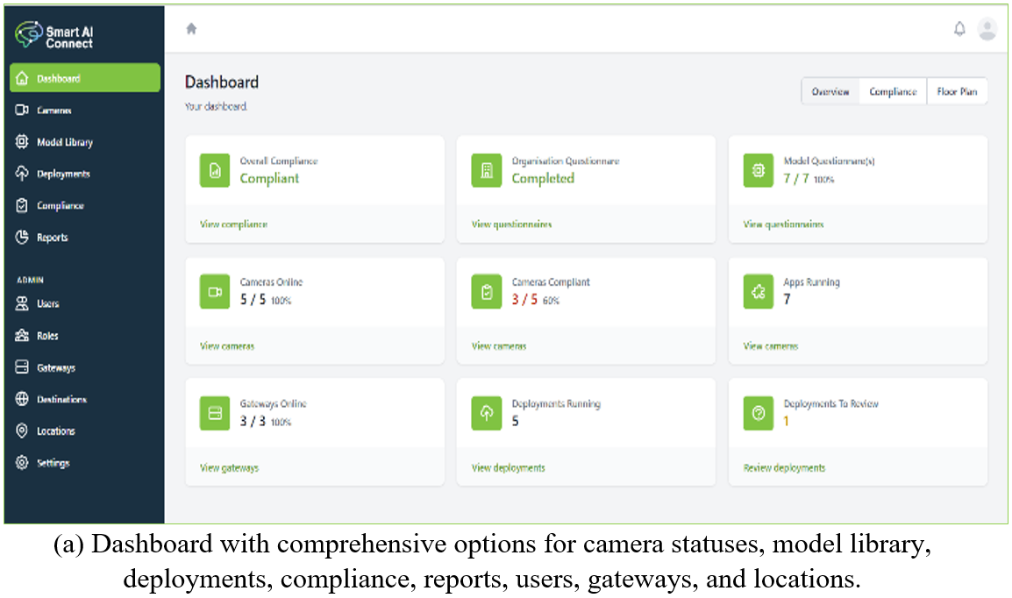
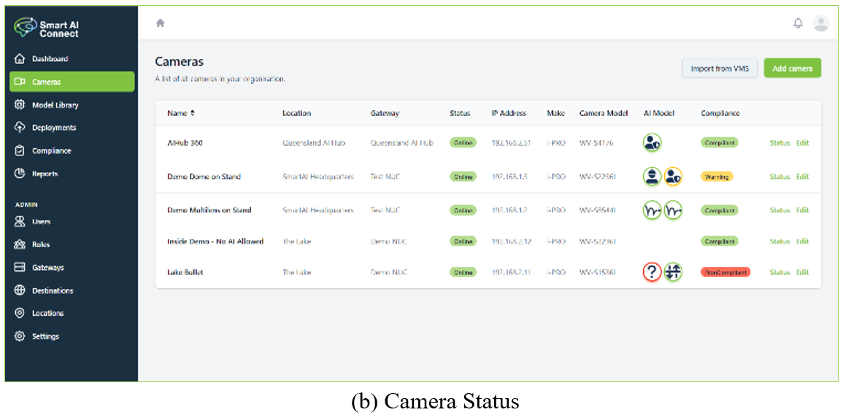
Management Platform
Figure 8. Screenshots of the management platform

Slide 18
Comparative Analysis
Table 4. Comparative Analysis
Model Name | Speed on CPU (ms) for 37 FPS | mAP (%) | mAR (%) | Classes | Parameters
YOLOv5 | 28 | 50.5 | 44.1 | 80 | 7.30 million
Faster R-CNN (ResNet-50) | 85 | 36.8 | 34.0 | 80 | 41.50 million
EfficientDet-D0 | 50 | 33.6 | 32.5 | 90 | 3.90 million
YOLOv3 | 45 | 33.0 | 31.4 | 80 | 62.00 million
SSD ResNet-50 FPN | 80 | 39.0 | 35.0 | 90 | 44.00 million
Baseline: SSD MobileNet V2 (COCO)** | 27 | 22.0 | 27.0 | 90 | 3.47 million
Proposed method v1 | 27 | 29.0 | 66.0 | 10 | 3.47 million
**TensorFlow Model Zoo reference metric is "DetectionBoxes_Precision/mAP" (aka AP @[ IoU=0.50:0.95 | area = all | maxDets=100 ]”).

Slide 19
Limitations
People who are distant from the camera (a pupillary distance of <10 px) and people who are too small might not be detected when the image resolution gets smaller.
The performance will degrade when running on CCTV streams zoomed out too far making people hard to detect.
The model is not designed to estimate the size of a crowd. Therefore, when the crowd in front of the camera increases, the predictions will be incorrect.
The model’s performance may be impacted by variations in weather, camera angle, and other environmental factors that are not present in the training data. This means that the model may not perform as well in situations that differ significantly from the conditions it was trained on.
Partially hidden, obstructed people and blurry people might not be detected.
When people are overlapping, the models’ performance might degrade.

Slide 20
Conclusion
The proposed approach can be used to identify people wearing hard hats and vests on AI-enabled CCTV cameras with or without VMS.
The model could be used in a variety of applications, such as safety inspections in construction sites, factories, or other industrial settings, quality control in manufacturing or production lines, and surveillance and security systems in public places or private facilities.
The model can be used as a tool to assist human operators in identifying potential safety hazards or non-compliance with PPE regulations.
However, the model is not intended to replace human judgment or expertise, and its results should be carefully reviewed by qualified personnel before taking any action.
It is important to carefully evaluate the model performance on a representative set of test data and consider its limitations and potential biases before deploying it in a real-world application.
It is also important to ensure that appropriate safety measures are in place to mitigate potential risks associated with the use of the model.

Slide 21
Future Work
Optimization of small target recognition with the objective of enhancing detection accuracy
Evaluate the model on open source benchmarks and some other real-world data captured from different environments and populations
Increase the size of the input images, include more images by changing the position of holding headgear (ex: different stages of wearing and removing the headgear) into the training pool
Extend the dataset for other safety equipment such as gloves, work boots, goggles, masks, respirators, etc.
Implement mechanisms to detect and account for slip, trip, and fall activities in the workplace, ensuring comprehensive action detection.
Use infrared or multi-spectrum images to further enhance the model’s performance in low-light and adverse weather conditions.

Slide 22
References
FACTS ON Safety at Work; ILO: Geneva, Switzerland, 2005; Available online: https://www.ilo.org/wcmsp5/groups/public/---dgreports/---dcomm/documents/publication/wcms_067574.pdf (accessed on 23 September 2022).
Construction Industry Profile; Safe Work Australia: Canberra, Australia, 2015. Available online: https://www.safeworkaustralia.gov.au/system/files/documents/1702/construction-industry-profile.pdf (accessed on 23 September 2022).
“Hard Hat Workers Dataset”. Distributed by Roboflow. Available online: https://public.roboflow.com/object-detection/hardhat-workers (accessed on 22 August 2022).
Welcome to MaxusAI. Available online: https://www.maxusai.com/ (accessed on 25 June 2022).

Slide 23
Thank You

Slide 24
Q & A
My Current Research:
RMIT: Diffusion modelling for synthetic biometric data generation
Griffith: A novel automatic neural network feature extractor with explanations and non-iterative learning
Contact:
RMIT: pubudu.sanjeewani.thihagoda.gamage@rmit.edu.au
Griffith: p.thihagodagamage@griffith.edu.au
Personal: pubudusanjeewani91@gmail.com

